Slide 1
Large Scale Machine Learning
Part 2: Distributed Logistic Regression

Slide 2
Synchronous Distributed SGD
The goal is to reduce communication cost
Exploiting sparsity
Compression
Increasing computation
Works reasonably well in practice
Can also give a good initial solution to be fine tuned with more complex methods
Notes:
Dernier fois : comment réduire communication
Ok en pratique, mais comment faire encore mieux?

Slide 3
In Spark
// Load training data in LIBSVM format.
val data = MLUtils.loadLibSVMFile(sc, "data/mllib/sample_libsvm_data.txt")
// Split data into training (60%) and test (40%).
val splits = data.randomSplit(Array(0.6, 0.4), seed = 11L)
val training = splits(0).cache()
val test = splits(1)
// Run training algorithm to build the model
val model = new LogisticRegressionWithSGD()
.setNumClasses(10)
.run(training)
// Compute raw scores on the test set.
val predictionAndLabels = test.map { case LabeledPoint(label, features) =>
val prediction = model.predict(features)
(prediction, label)
}
Notes:
Tout cette complexité est déjà implémenté dans la spark mllib. 15 lignes de code vs 1000 ?

Slide 4
Other ways to distribute
Two major costs: Communication and synchronization
We talked about reducing communication cost in different ways while staying in a synchronous centralized manner
We will discuss two additional ways
Asynchronous updates: Parameter Server
Efficient Aggregation: All Reduce
Notes:
Last time we said we could drop the gradients of the slowest workers
Better ways to deal with synchornisation ? Parameter server
Better ways to aggregate ? All reduce

Slide 5
Parameter Server design rationale
Model updates to be generally in the right direction
Not important to have strong consistency guarantees all the time
Model updates are often sparse
No need to pull all model parameters and push all of them
Separate computation and storage
Notes:
Sur un cluster de 100 machines il y aura des machines lentes

Slide 6
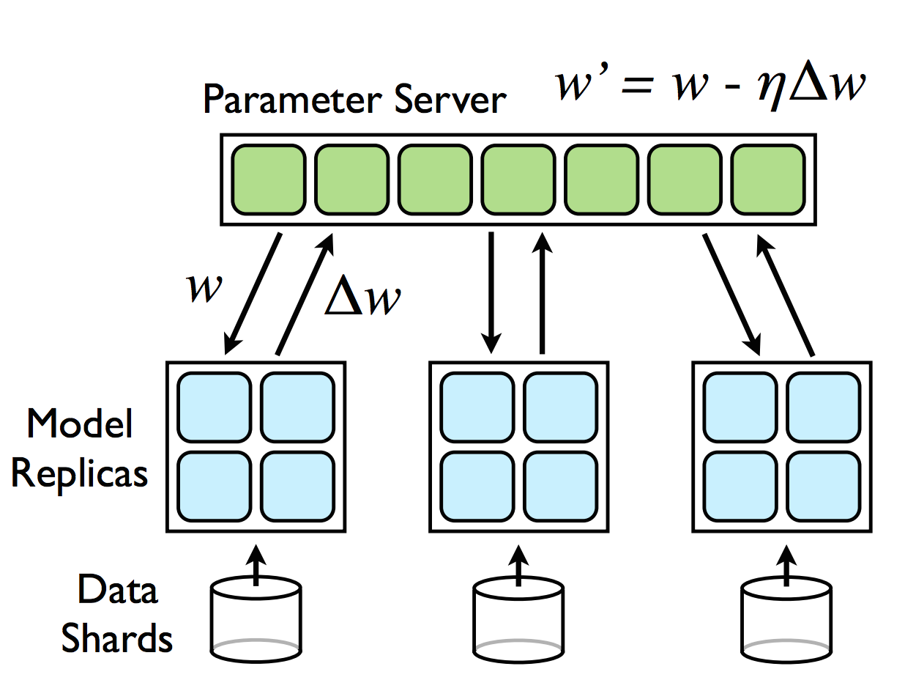
Parameter Server design rationale
Lock free asynchronous updates
HOGWILD!
Introducing asynchrony makes the system fault tolerant
If a worker fails while computing gradient, no need to wait, just restart the computation
Notes:
Très utilisé en deep, tf le permet,
Comment ça fonctionne ?
W stocké sur un server, loss calculé sur le worker, delta w retourné.
Quel est le risque ici ?
Expliquer la sparsité à la fin : besoin que d’une partie sur chaque worker.
-> rappel : meilleurs couts de communications
-> pas trop de collision
Howild : Garanties théoriques

Slide 7
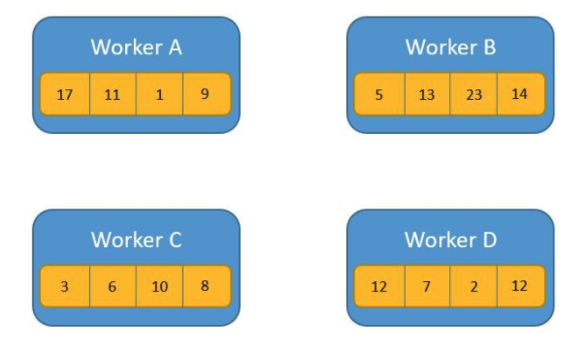
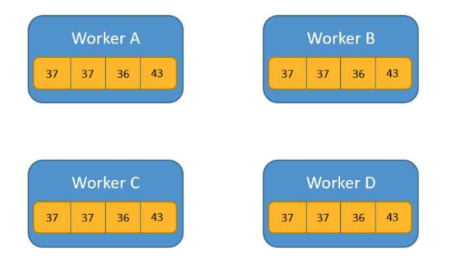
AllReduce
Notes:
On sort du monde du parameter server
AllReduce
Average all the values in all the computation nodes and send the averages value to all the nodes
Example: averaging gradients !

Slide 8
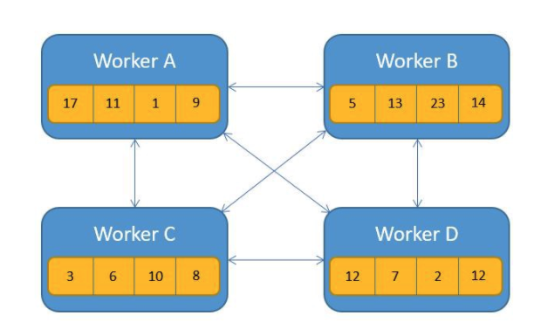
AllReduce: all to all communication
Notes:
implémentation super naïve
Saturate messaging network
Qui peut m’expliquer comment spark fonctionne par défaut pour les aggrégations?

Slide 9
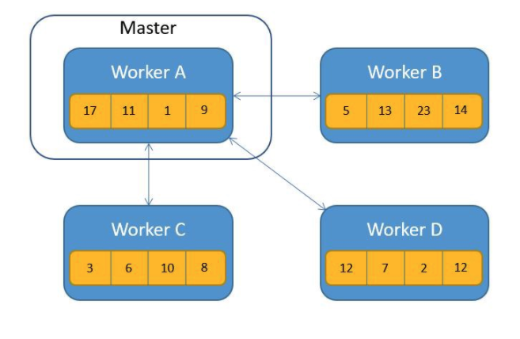
AllReduce: Reduce then Broadcast
Notes:
Naive: Reduce and then Broadcast like the first Spark snippet
Driver becomes the bottleneck

Slide 10
AllReduce
Notes:
Implementation
Optimized: do both reduce and communicate at the same time
Plein de gens ont passé du temps sur ce probleme spécifique : communiquer et aggréger
Tree aggregate spark
Définir schéma de commiunication nb fleche vs depth
Tree : attention, gradients de moins en moins sparse
Tree all reduce is the same as reduce and then broadcast: 5 comm steps
Butterfly all reduce: 3 comm steps

Slide 11
Ring AllReduce

Slide 12
Ring AllReduce

Slide 13
Ring AllReduce

Slide 14
Ring AllReduce

Slide 15
How to speedup gradient descent?
Up to now: faster gradient computation
Distributed
Optimize communication cost
Reduce synchronization overhead
Everything we said is widely applicable
You just need a differentiable model
Model parameters fit on one machine
Loss is a sum of pointwise losses over training examples
Another way: smarter optimization algorithms
Line search
2nd order methods

Slide 16
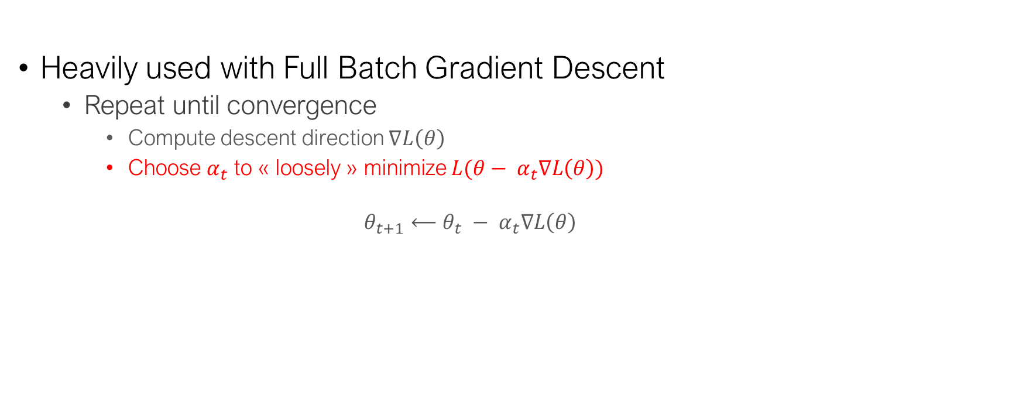
Line search
Heavily used with Full Batch Gradient Descent
Repeat until convergence
Compute descent direction $∇L\left(θ\right)$
Choose $α_{t}$ to « loosely » minimize $L(θ− α_{t}∇L\left(θ\right))$
$$θ_{t+1}⟵θ_{t} − α_{t}∇L\left(θ\right)$$
Notes:
Dessin au tableau

Slide 17
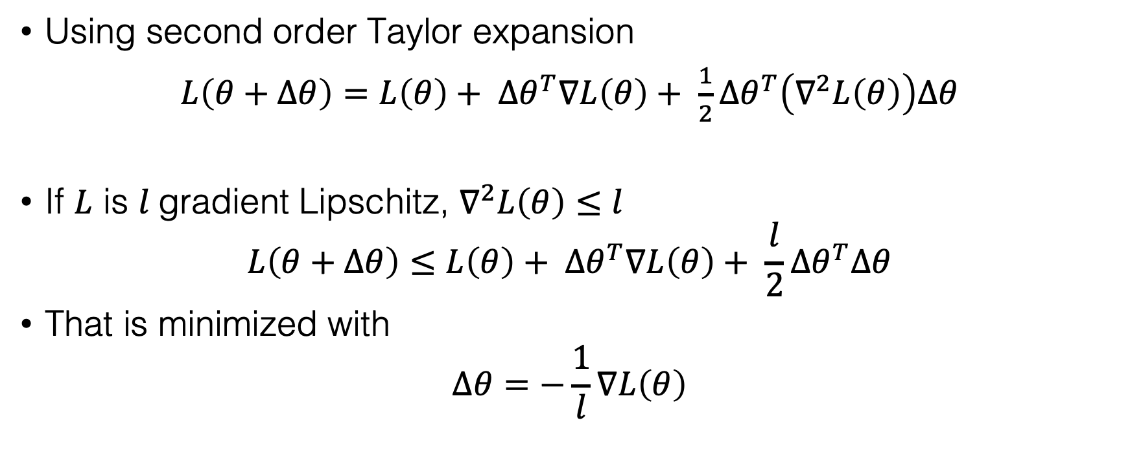
Theoretical guarantees
Using second order Taylor expansion
$L\left(θ+Δθ\right)=L\left(θ\right)+ {Δθ}^{T}∇L\left(θ\right)+ \frac{1}{2}{Δθ}^{T}\left(∇^{2}L\left(θ\right)\right)Δθ$
If $L$ is $l$gradient Lipschitz, $∇^{2}L\left(θ\right)≤l$
$$L\left(θ+Δθ\right)≤L\left(θ\right)+ {Δθ}^{T}∇L\left(θ\right)+ \frac{l}{2}{Δθ}^{T}Δθ$$
That is minimized with
$$Δθ=−\frac{1}{l}∇L\left(θ\right)$$

Slide 18
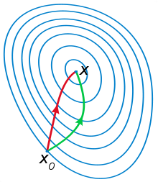
Second order optimization methods
We want to speed up our convergence in another way
Using the “curvature” information can help a lot

Slide 19
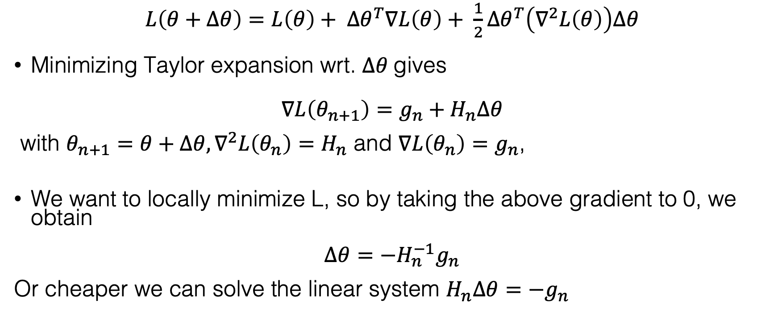
Newton’s method
$L\left(θ+Δθ\right)=L\left(θ\right)+ {Δθ}^{T}∇L\left(θ\right)+ \frac{1}{2}{Δθ}^{T}\left(∇^{2}L\left(θ\right)\right)Δθ$
Minimizing Taylor expansion wrt. $Δθ$gives
$$∇L\left(θ_{n+1}\right)=g_{n}+H_{n}Δθ$$
with $θ_{n+1}=θ+Δθ,∇^{2}L\left(θ_{n}\right)=H_{n}$ and $∇L\left(θ_{n}\right)=g_{n}$,
We want to locally minimize L, so by taking the above gradient to 0, we obtain
$$Δθ=−H_{n}^{−1}g_{n}$$
Or cheaper we can solve the linear system $H_{n}Δθ=−g_{n}$

Slide 20
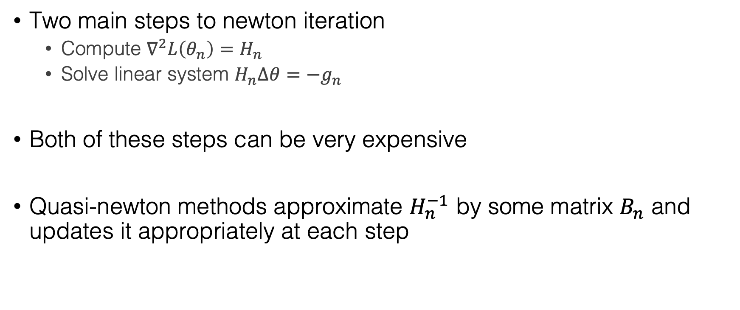
Quasi-newton methods
Two main steps to newton iteration
Compute $∇^{2}L\left(θ_{n}\right)=H_{n}$
Solve linear system $H_{n}Δθ=−g_{n}$
Both of these steps can be very expensive
Quasi-newton methods approximate $H_{n}^{−1}$ by some matrix $B_{n}$ and updates it appropriately at each step

Slide 21
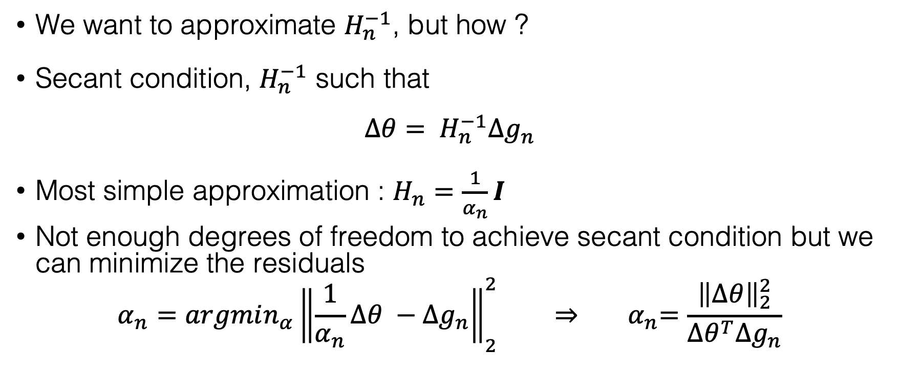
Barzilai Borwein step size
We want to approximate $H_{n}^{−1}$, but how ?
Secant condition, $H_{n}^{−1}$ such that
$${Δθ= H}_{n}^{−1}Δg_{n}$$
Most simple approximation : $H_{n}=\frac{1}{α_{n}}I$
Not enough degrees of freedom to achieve secant condition but we can minimize the residuals
$$α_{n}=argmin_{α}{\left\|\frac{1}{α_{n}}Δθ −Δg_{n}\right\|}_{2}^{2} ⇒{ α}_{n}=\frac{{\left\|Δθ\right\|}_{2}^{2}}{Δθ^{T}Δg_{n}}$$

Slide 22
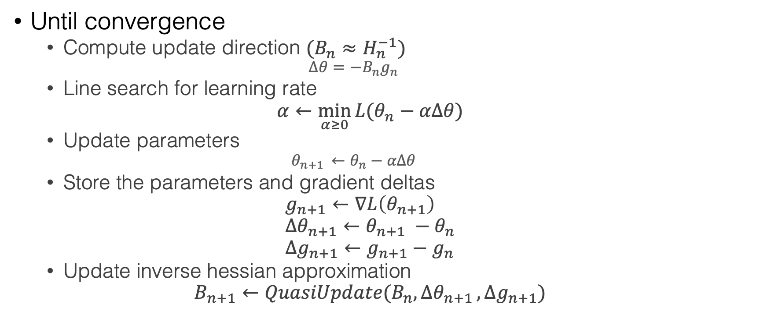
Quasi-newton methods : generic
Until convergence
Compute update direction $(B_{n}≈H_{n}^{−1}$)
$$Δθ=−B_{n}g_{n}$$
Line search for learning rate
$$α←\min_{α≥0}{L(θ_{n}−αΔθ)}$$
Update parameters
$${θ_{n+1 }←θ}_{n}−αΔθ$$
Store the parameters and gradient deltas
$$g_{n+1}←∇L\left(θ_{n+1}\right) \\ {Δθ}_{n+1}←θ_{n+1} −θ_{n} \\ {Δg}_{n+1}←g_{n+1}−g_{n}$$
Update inverse hessian approximation
$$B_{n+1}←QuasiUpdate(B_{n}{,Δθ}_{n+1},{Δg}_{n+1})$$

Slide 23
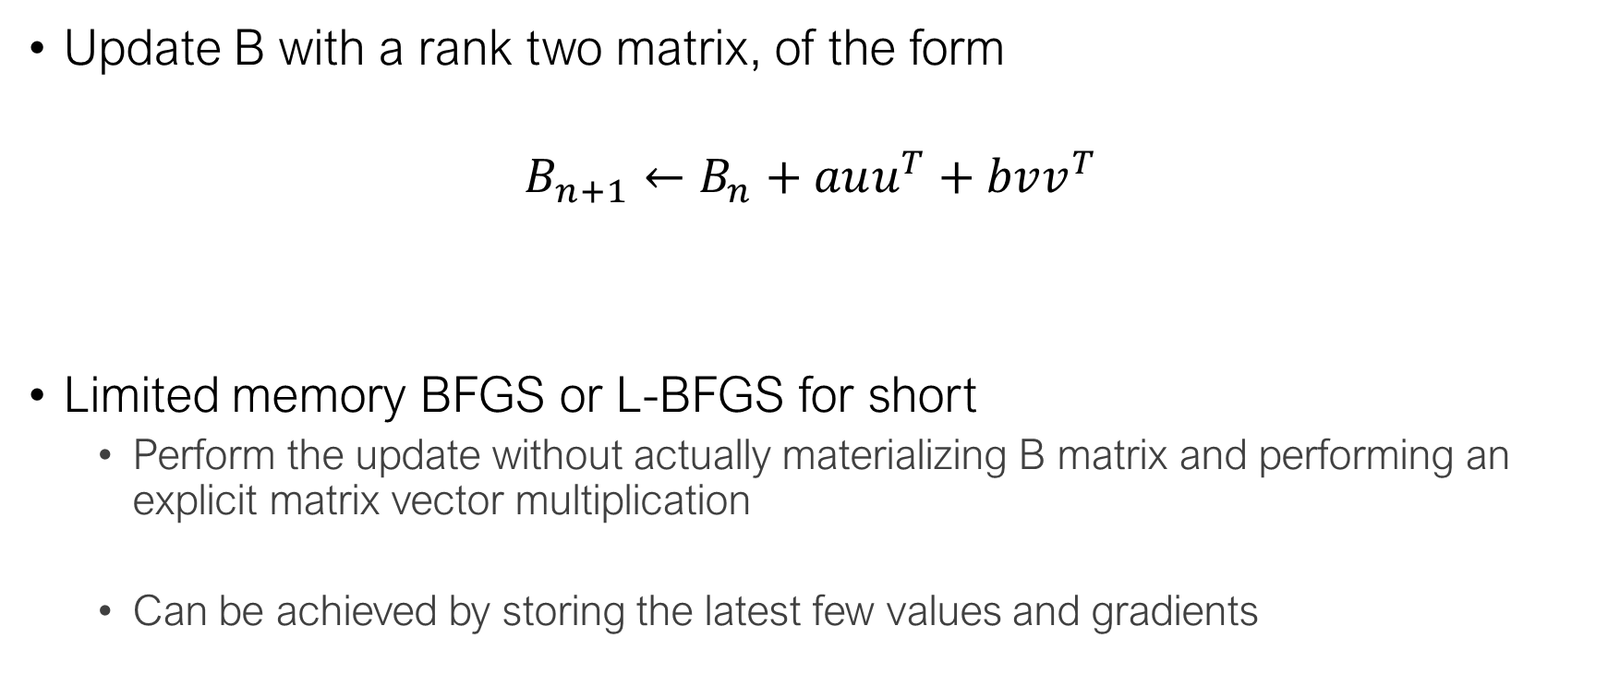
BFGS
Update B with a rank two matrix, of the form
$$B_{n+1}←B_{n}+auu^{T}+bvv^{T}$$
Limited memory BFGS or L-BFGS for short
Perform the update without actually materializing B matrix and performing an explicit matrix vector multiplication
Can be achieved by storing the latest few values and gradients

Slide 24
Why are we talking about this ?
We can now perform second order updates just with the (full) gradient
Gradient computation is embarassingly parallel
L-BFGS works very well in practice and converges in very few epochs (so we increase the computation to reduce the communication overhead)

Slide 25
Conclusion
Distributed Machine Learning is about trade-offs
Communication VS computation cost
For simple models (like Logistic Regression), a synchronous approach works well
Exploit sparsity
Use more complex optimization schemes
There are several ways to distribute and aggregate computation
Centralized synchronous or asynchronous model, AllReduce …
Notes:
Pas de formule magique pour tous les problèmes,
Compréhension fine de la tache
Important de comprendre les spécificités du problème en cours, les simplifications possibles pour trouver la meilleure solution.

Slide 26
AllReduce
AllReduce
Average all the values in all the computation nodes and send the averages value to all the nodes
Example: averaging gradients !
Implementation
Naive: Reduce and then Broadcast like the first Spark snippet
Optimized: do both at the same time
Notes:
On va passer aux différents systeme d’aggrégation
Qui peut m’expliquer comment spark fonctionne par défaut pour les aggrégations?

